Slide 1
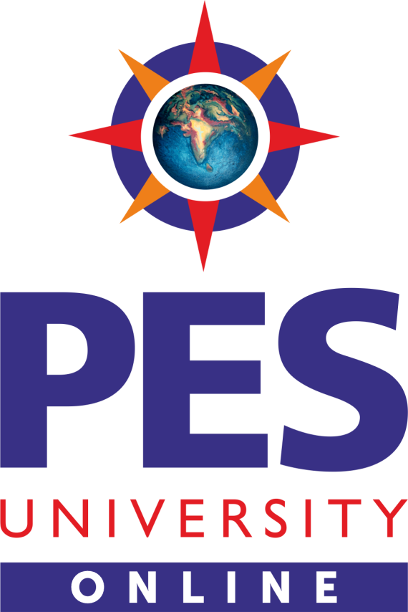
OPERATING SYSTEMS
Kernel Data Structures and Computing Environments
Venkatesh Prasad
Department of Computer Science

Slide 2
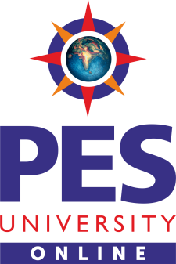
OPERATING SYSTEMS
Slides Credits for all PPTs of this course
The slides/diagrams in this course are an adaptation, combination, and enhancement of material from the following resources and persons:
Slides of Operating System Concepts, Abraham Silberschatz, Peter Baer Galvin, Greg Gagne - 9th edition 2013 and some slides from 10th edition 2018
Some conceptual text and diagram from Operating Systems - Internals and Design Principles, William Stallings, 9th edition 2018
Some presentation transcripts from A. Frank – P. Weisberg
Some conceptual text from Operating Systems: Three Easy Pieces, Remzi Arpaci-Dusseau, Andrea Arpaci Dusseau

Slide 3
Operating systems
Kernel Data Structures
Venkatesh Prasad
Department of Computer Science

Slide 4
OPERATING SYSTEMS
Lists
Standard programming data structures are used extensively in OS
Singly linked list
Doubly linked list
Circular linked list
Notes:
To store the data item whose size may vary.
To remove an item if the relative positions of the remaining data items must be preserved
Lists are sometimes used directly by Kernel algorithms. The lists are also used for constructing more powerful data structures, such as stacks and queues.

Slide 5
OPERATING SYSTEMS
Stacks & Queues
Stack uses LIFO principle
OS often uses a stack when involving function calls.
Parameters, local variables and the return address are pushed onto the stack when a function is called
Return from the function call pops those items off the stack
Queue uses FIFO principle
Tasks waiting to be run on an available CPU are organized in queues
Print jobs sent to a printer are printed in the order of submission

Slide 6
OPERATING SYSTEMS
Trees
Data structure used to represent data hierarchically
Binary search tree ordering between 2 children: left <= right
Search performance is O(n)
Balanced binary search tree is O(lg n)
Used by Linux as part its CPU-Scheduling algorithm for selecting which task to run next
Notes:
N is the number of nodes in the tree

Slide 7
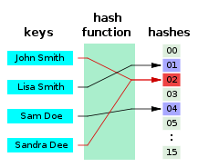
OPERATING SYSTEMS
Hash Functions and Maps
Hash functions can result in the same output value for 2 inputs
Hash function can be used to implement a hash map
Maps or associates key:value pairs using a hash function
Notes:
Example: Used for password authentication. When a user name is mapped to a password, the hash function is applied to the user name, which is then used to retrieve the password.

Slide 8
OPERATING SYSTEMS
Bitmaps
Bitmap - string of n binary digits representing the status of n items
Availability of each resource is indicated by the value of a binary digit
0 – resource is available
1 – resource is unavailable
Value of the i^{th} position in the bitmap is associated with the i^{th} resource
Ex: bitmap 001011101 shows resources 2, 4, 5, 6, and 8 are unavailable; resources 0, 1, 3, and 7 are available

Slide 9
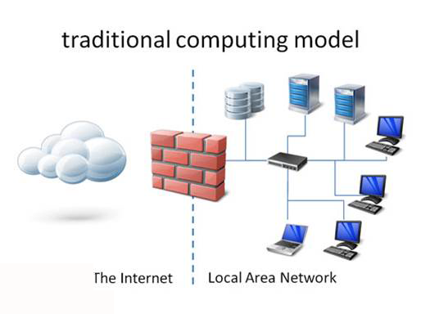
OPERATING SYSTEMS
Computing Environments – Traditional
Stand-alone general purpose machines
But blurred as most systems interconnect with others (i.e., the Internet)
Portals provide web access to internal systems
Network computers (thin clients) are like Web terminals
Mobile computers interconnect via wireless networks
Networking becoming ubiquitous – even home systems use firewalls to protect home computers from Internet attacks

Slide 10
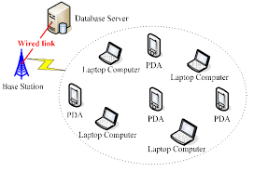
OPERATING SYSTEMS
Computing Environments – Mobile
Handheld smartphones, tablets, etc
What is the functional difference between them and a “traditional” laptop?
Extra feature – more OS features (GPS, gyroscope)
Allows new types of apps like augmented reality
Use IEEE 802.11 wireless, or cellular data networks for connectivity
Leaders are Apple iOS and Google Android

Slide 11
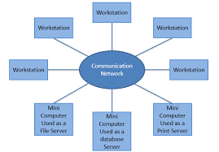
OPERATING SYSTEMS
Computing Environments – Distributed
Distributed computing
Collection of separate, possibly heterogeneous, systems networked together
Network is a communications path, TCP/IP most common
Local Area Network (LAN)
Wide Area Network (WAN)
Metropolitan Area Network (MAN)
Personal Area Network (PAN)
Network Operating System provides features between systems across network
Communication scheme allows systems to exchange messages
Illusion of a single system

Slide 12
OPERATING SYSTEMS
Computing Environments – Client-Server
Client-Server Computing
Dumb terminals replaced by smart PCs
Many systems now servers, responding to requests generated by clients
Compute-server system provides an interface to client to request services (i.e., database)
File-server system provides interface for clients to store and retrieve files

Slide 13
OPERATING SYSTEMS
Computing Environments – Peer-to-Peer
Another model of distributed system
P2P does not distinguish clients and servers
Instead all nodes are considered peers
May each act as client, server or both
Node must join P2P network
Registers its service with central lookup service on network, or
Broadcast request for service and respond to requests for service via discovery protocol
Examples include Napster and Gnutella, Voice over IP (VoIP) such as Skype

Slide 14
OPERATING SYSTEMS
Computing Environments – Virtualization
Allows operating systems to run applications within other OSes
Vast and growing industry
Emulation used when source CPU type different from target type (i.e. PowerPC to Intel x86)
Generally slowest method
When computer language not compiled to native code – Interpretation
Virtualization – OS natively compiled for CPU, running guest OSes also natively compiled
Consider VMware running WinXP guests, each running applications, all on native WinXP host OS
VMM (virtual machine Manager) provides virtualization services
Notes:
Virtualization is a technology that allows OS’s to run as applications within other OS’s. Many applications are run on the computer and each application demands its own environment (such as specific version of OS, multiple processors and disks).
Virtualization decouples OS and service from hardware

Slide 15
OPERATING SYSTEMS
Computing Environments – Virtualization
Use cases involve laptops and desktops running multiple OSes for exploration or compatibility
Apple laptop running Mac OS X host, Windows as a guest
Developing apps for multiple OSes without having multiple systems
QA testing applications without having multiple systems
Executing and managing compute environments within data centers
VMM can run natively, in which case they are also the host
There is no general purpose host then (VMware ESX and Citrix XenServer)
Notes:
A virtual machine provides interface identical to underlying bare hardware.
Once the VM is created with some no of processors, some amount of RAM & storage resources, it only sees the resources it has been configured with, not all of the resources of the physical host itself.

Slide 16
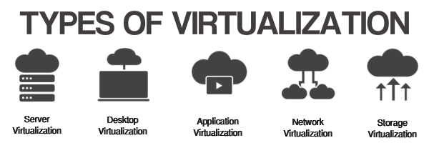

OPERATING SYSTEMS
Computing Environments – Virtualization

Slide 17
OPERATING SYSTEMS
Computing Environments – Cloud Computing
Delivers computing, storage, even apps as a service across a network
Logical extension of virtualization because it uses virtualization as the base for it functionality.
Amazon EC2 has thousands of servers, millions of virtual machines, petabytes of storage available across the Internet, pay based on usage
Many types
Public cloud – available via Internet to anyone willing to pay
Private cloud – run by a company for the company’s own use
Hybrid cloud – includes both public and private cloud components

Slide 18
OPERATING SYSTEMS
Computing Environments – Cloud Computing
Software as a Service (SaaS) – one or more applications available via the Internet (i.e., word processor)
Platform as a Service (PaaS) – software stack ready for application use via the Internet (i.e., a database server)
Infrastructure as a Service (IaaS) – servers or storage available over Internet (i.e., storage available for backup use)

Slide 19
OPERATING SYSTEMS
Computing Environments – Cloud Computing
Cloud computing environments composed of traditional OSes, plus VMMs, plus cloud management tools
Internet connectivity requires security like firewalls
Load balancers spread traffic across multiple applications

Slide 20
OPERATING SYSTEMS
Computing Environments – Real-Time Embedded Systems
Real-time embedded systems most prevalent form of computers
Vary considerable, special purpose, limited purpose OS, real-time OS
Use expanding
Many other special computing environments as well
Some have OSes, some perform tasks without an OS
Real-time OS has well-defined fixed time constraints
Processing must be done within constraint
Correct operation only if constraints met

Slide 21
THANK YOU
Venkatesh Prasad
Department of Computer Science Engineering
venkateshprasad@pes.edu

